Slide 1



Find Your Next Favorite Movie
Welcome to our movie recommender website, where we help you discover new movies based on your personal preferences. With an extensive database of high-quality movies and a powerful algorithm, we are here to provide you with the best movie recommendations. Let's get started!

Slide 2

How the Recommender Works
Our movie recommender works by using a powerful algorithm to analyze your personal preferences and movie history. Based on your data, it suggests movies that you are most likely to enjoy. The more you use it, the better it gets. Give it a try and see for yourself!

Slide 3

User Profile and Preferences
To use our movie recommender, create a user profile and fill in your movie preferences. The more detailed your preferences, the better our algorithm will provide you with movie recommendations. You can also rate and review movies to give us feedback on our recommendations.
Create a User Profile
Get Movie recommendations
Rate and Review Movies
Add your name, email, and password so you can access your personalized movie recommendations.
Based on your recently watched movies get further
recommendations.
Rate and review movies to improve our algorithm recommendations and share your opinion with other users.

Slide 4
Why Should you use it ?
Our website is the go-to destination for movie recommendations because it offers a unique advantage: irrespective of platforms, users receive tailored movie suggestions spanning across all streaming services. This convenience ensures that you receive valuable recommendations regardless of the platform you prefer, making your movie-watching experience hassle-free and enjoyable.

Slide 5


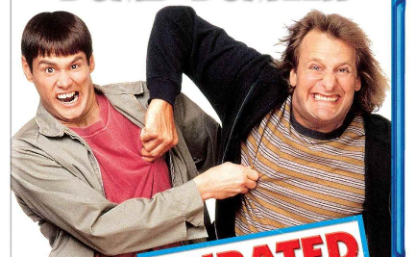
Movie Database
We have an extensive database of movies, including the latest releases and timeless classics. We add new movies regularly to ensure that our selection remains up to date and relevant. Browse our collection and find your next favorite movie!
Action Movies
Drama Movies
Comedy Movies
Looking for an adrenaline rush? Check out our selection of action movies that are sure to get your heart racing.
Whether you need a good cry or enjoy thought-provoking films, our selection of drama movies has something for everyone.
Need a good laugh? Our selection of comedy movies will have you rolling on the floor laughing.

Slide 6
Algorithm for Movie Recommendations
Our algorithm for movie recommendations is based on machine learning and predictive analytics. It analyzes your movie preferences and movie history to suggest movies that you are most likely to enjoy. Our algorithm also takes into account factors such as movie popularity, user ratings, and movie release date.
Personalized Recommendations
Smart Suggestions
Continuous Learning
Our algorithm uses predictive analytics to suggest movies that fit your unique tastes, even if it's not a direct match.
Our algorithm provides personalized recommendations based on your personal preferences and movie history.
Our algorithm continuously learns from your feedback in order to improve the accuracy of its recommendations over time.

Slide 7
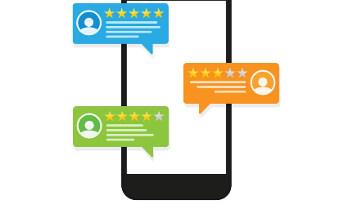

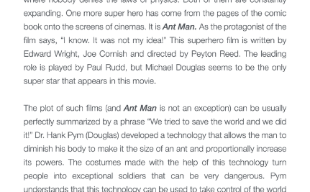
User Reviews and Ratings
Our user reviews and ratings section provides an opportunity for you to share your opinions on the movies you watch. By rating and reviewing movies, you help our algorithm learn and improve its recommendations. You can also read reviews from other users to discover new movies and get a sense of what others think of movies you are interested in.
Rate and Review Movies
User Ratings
User Reviews
Rate and review movies to improve our algorithm's recommendations and share your opinion with other users.
View user ratings to see what others think of popular movies and get a sense of whether a movie is worth watching.
Read user reviews to discover new movies and get a sense of what others think of movies you are interested in.

